Slide 1
Insurance Fraud Detection
Annette van Aarde
11 April 2025

Slide 2
Problem Statement
Insurance fraud is a growing issue which costs billions annually.
Traditional fraud detection methods are time-consuming and reactive.
There is a need for a data-driven and automated solution flagging suspicious claims.

Slide 3
Project Objectives
Analyze insurance claims to understand trends.
Identify key features that may contribute to fraudulent activity.
Train and evaluate multiple machine learning models.
Build an interactive Power BI dashboard to generate insights.
Recommend solutions to enhance fraud detection practices.

Slide 4
Data Source & Discription
Data was downloaded from GitHub and contained data of approximately 1,000 insurance claims.
Data consisted of 9 columns including the following: policy_annual_premium, auto_make, auto_model, Insured_education_level, policy_deductable.
The target was fraud_reported (Yes/No).

Slide 5
Data Cleaning Process
The original data was cleaned in Excel:
Removed blank and irrelevant columns.
Identified and deleted rows with missing values.
Validated summary stats: min, max, mean & mode.
Final cleaned dataset was saved as .csv for modeling and visualization.

Slide 6
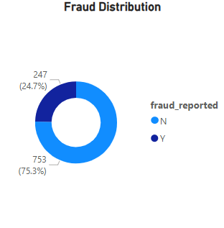
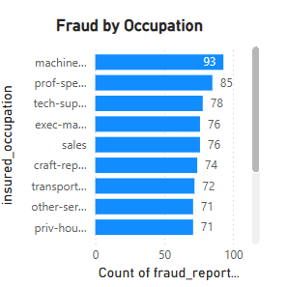
Exploratory data Analysis
24,7% of claims were flagged as fraudulent.
Key Insights:
Higher fraud rates were linked to specific occupations such as Clerical, Machine Operator.
Higher annual_premium often tied to fraud.
Some vehicle makes like Dodge, Chevrolet were more common amongst fraud claims.
Education and Occupation have meaningful influence.

Slide 7
Feature Engineering & Encoding
Encoded categorical features using Label Encoding.
Identified and removed low-variance features.
Scaled continuous variables if needed like premiums.
Selected top features using importance scores from Random Forest.

Slide 8
Feature Engineering & Encoding
Encoded categorical features using Label Encoding.
Identified and removed low-variance features.
Scaled continuous variables if needed like premiums.
Selected top features using importance scores from Random Forest.

Slide 9
Modelling Approach
The following algorithms were evaluated:
Logistic Regression
Decision Tree Classifier
Random Forest Classifier
The final choice was the Random Forrest – due to high performance and ability to handle mixed feature types.
I used train/test split with 80/20 ratio.

Slide 10
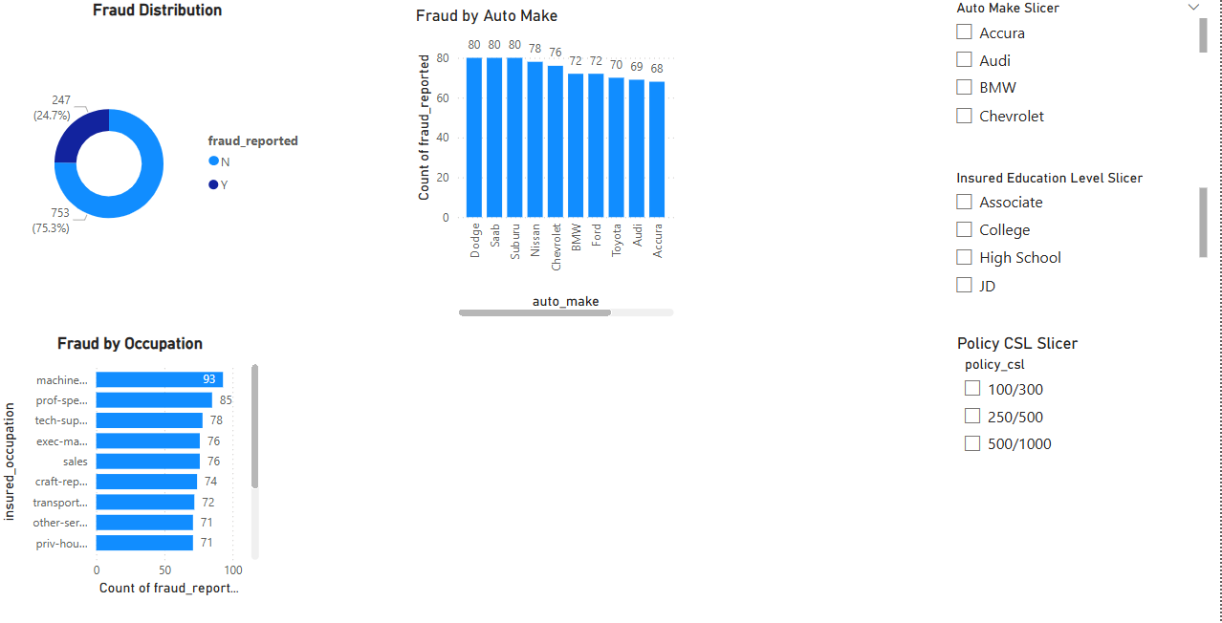
Power BI Dashboard Highlights
An interactive dashboard was created for business insights:
Fraud by occupation, education and auto make.
Slicers for filtering by policy limits, vehicle make, etc.
This enables business users to explore patterns and make real-time decisions.

Slide 11
Final Model Summary
Model: Random Forest Classifier
Top Features: policy_annual_premium, insured_occupation, auto_make, insured_education_level
Why it was chosen:
Handles mixed data types well.
High accuracy and balanced recall.
Easy to imterpret with feature importances.

Slide 12
Key Takeaways
Fraud detection will benefit greatly from machine learning.
Specific attributes are strong fraud indicators such as occupation, premium, etc.
Power BI helps visualize complex fraud trends interactively.
Predictive modelling can reduce manual review effort and financial losses.

Slide 13
Limitations
Small dataset – limited generalizability.
No geographic or behavioral data lie claim history.
May need additional features for real world deployment.
Imbalanced dataset may affect fraud detection sensitivity.

Slide 14
Future Work
Add geological and customer history to dataset.
Explore deep learning models for improved performance.
Integrate model with real-time claim processing systems.

Slide 15
Thank You!

